Slide 1
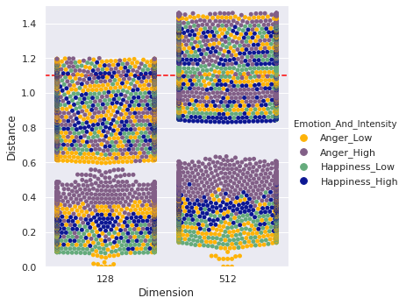
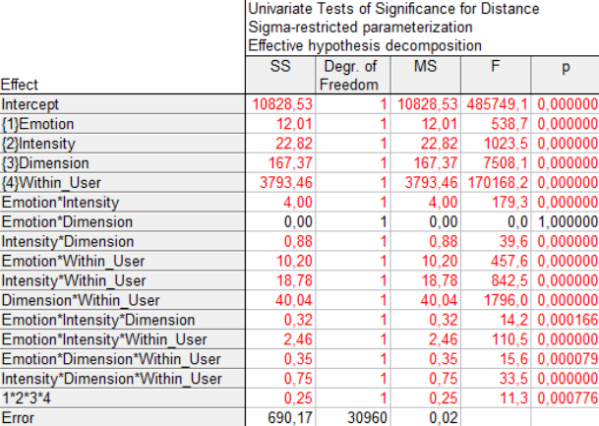
Detecting the effects of emotions and higher dimensional facial vectorization on facial recognition in a smart mirror system
Andras Toth¹, Patrik Toth², Szabolcs Meszaros³, Jozsef Halasz⁴
¹ sba.andras.toth@gmail.com
² patrikthetoth@gmail.com
³ villam983@gmail.com
⁴ halasz.jozsef@amk.uni-obuda.hu
Obuda University, Alba Regia Technical Faculty
Institute of Natural Science and Software Technologies
Introduction
Smart devices are part of our everyday life now. Most companies try to adapt their products to fit their customers as best as possible. The team’s vision is about a smart mirror, that utilizes face recognition to show meaningful information to its users while they perform menial tasks. The team's smart mirror project consist of three major components, one of these were the face recognition pipeline. Over the course of the project some results pointed out, that the current state of the pipeline is not sufficient, thus new technologies were adopted. Because of this change in the underlying technologies, we were able to achieve greater accuracy for our face recognition system. Using this newly gained accuracy a new goal was set, to detect the effects of different emotions on the face recognition pipeline accuracy, and using this data prepare our system to differentiate emotions on our users’ face.
Materials and methods
The 4 basic face features for this paper have been created with FaceGen Modeller, each with two emotions, anger and happiness. These sets were created for each emotion: neutral with the intensity between 0 and 10 %, low with the intensity between 20 and 30 % and high, with the intensity value between 50 and 60 % with 1 percent increments for all sets. Faces were compared using convolutional neural networks which quantify facial features in an n-dimensional vector. Then two vectors are compared by calculating the Euclidean distance of the two vectors. Results from a 128D and a 512D neural network were compared. More than 30 thousand data points were gathered during the tests, these contained the compared users’ data such as username, applied emotion, the emotions intensity, and the Euclidean distance within the 2 users. This type of distance was used in the FaceNet paper and was determined, that a distance of 1.1 would be a threshold between the same user (below 1.1) and another user (above 1.1).
Emotions and their intensities
Distance statistics
Fig 1. Dots represent measured distances.
Dot coloring represent the emotion and intensity combination. Layering only is expressed in measurements belonging to the same users (dots with smaller distances).
Table 1. General Linear Model (STATISTICA 7.0) was used in the examined 4- factorial design. p < 0.05 represents statistically significant difference between groups. The results of the interactions are also presented.
Conclusion
In conclusion, our result indicate that the 512-dimensional solution had higher sensitivity and the effect of emotional content on facial detection must be considered in later studies. It is self-evident, that those measurements that were performed between two different users resulted in higher distances, in this case emotion and their intensities did not resulted in a marked layering. Within the same users, different emotions resulted in a significant increase of distances, e.g. in high intensity anger, the distances doubled, compared to the neutral faces in 512-dimensional measurements.
The presented study proved, that the emotional qualities have great impact on the measured distances. In addition, it has been proven, that the 512-dimensional system handles these emotional qualities with greater finesse.
The research has been supported by the
NTP-HHTDK-19 grant.
AIS 2020

